Slide 1
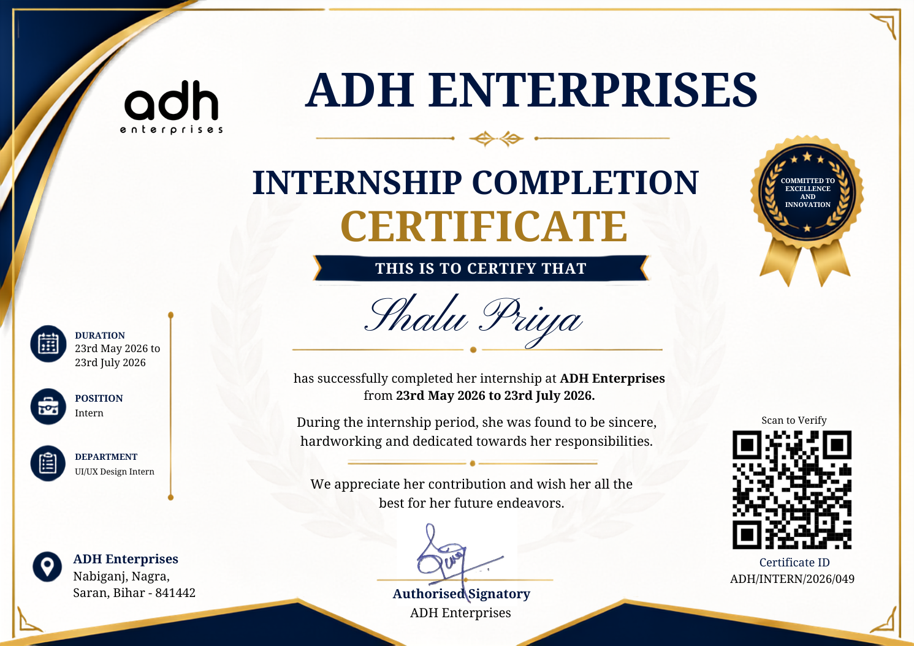
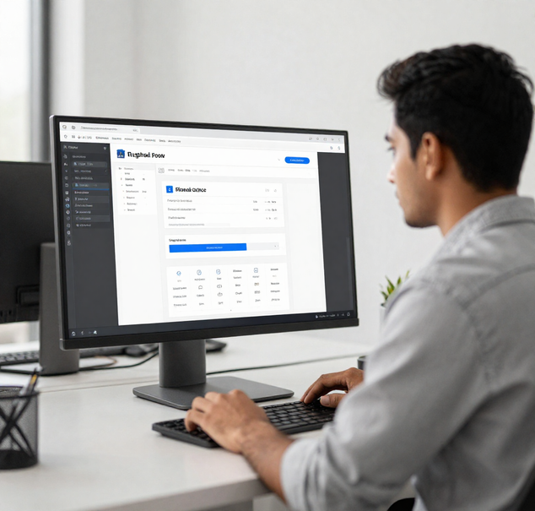
ADH ID
GENERATION SOFTWARE
Internship Presentation | Front End Design
Presented by:
Modassir Husain
ADH Enterprises
25SCS1003004509

Slide 2
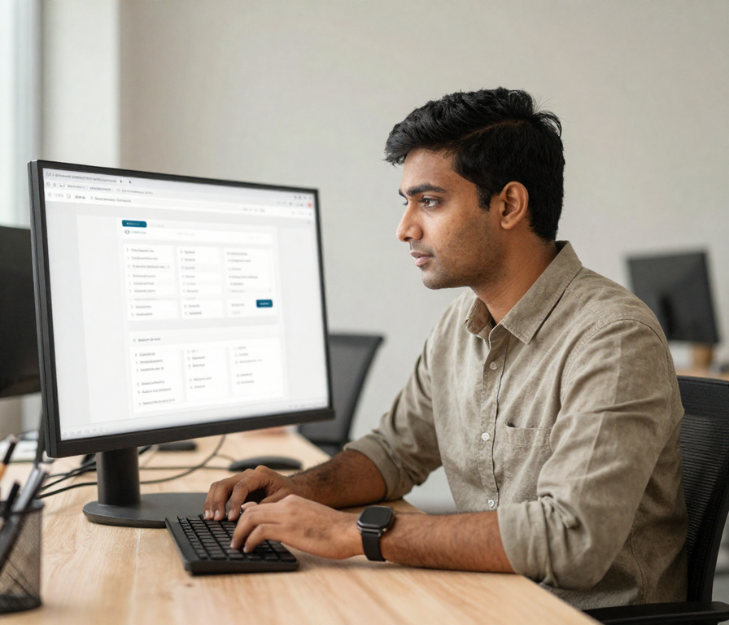
ROLE & INTERNSHIP FOCUS
• Responsible for front-end design across the ADH ID Generation Software
• Translated product requirements into clear, structured user interfaces
• Focused on layout planning, visual consistency, and usability across screens
• Coordinated with developers to ensure accurate and practical design implementation

Slide 3
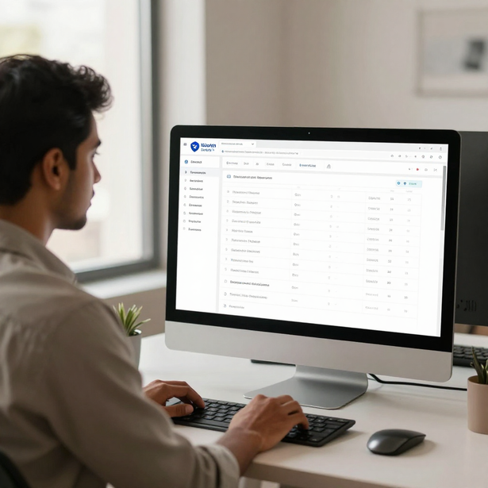
UNDERSTANDING THE PRODUCT
The ADH ID Generation Software is a web-based platform designed to centralize and simplify the creation of structured identity cards — giving organizations a single, reliable system to manage all ID-related operations.
Users interact with the platform to manage records (students, employees, parents), configure reusable ID templates, define structured workflows, and generate consistent, formatted ID outputs — all through a unified interface.
The core design challenge is making these complex, multi-step operations easy to follow. The interface must guide users through data entry, template selection, and output generation without confusion or repetitive manual effort.

Slide 4

USER INTERFACE CHALLENGES
• Presenting many data fields clearly without overwhelming the user
• Reducing visual confusion across complex record management screens
• Maintaining consistency across multiple screens and workflows
• Making ID generation workflows understandable and easy to follow

Slide 5

MY DESIGN CONTRIBUTION
• Led screen and layout planning for key modules of the ID generation platform
• Designed navigation structure to support intuitive user flow across the system
• Organized form layouts to reduce complexity and improve data entry clarity
• Established visual hierarchy to guide users through multi-step workflows
• Developed reusable interface patterns to ensure consistency across screens
• Conducted usability refinement through iteration and developer collaboration
As Front End Designer Intern at ADH Enterprises, Modassir Husain contributed directly to the design of the ADH ID Generation Software — translating product requirements into structured, user-friendly interfaces through planning, pattern development, and close collaboration with the development team.

Slide 6
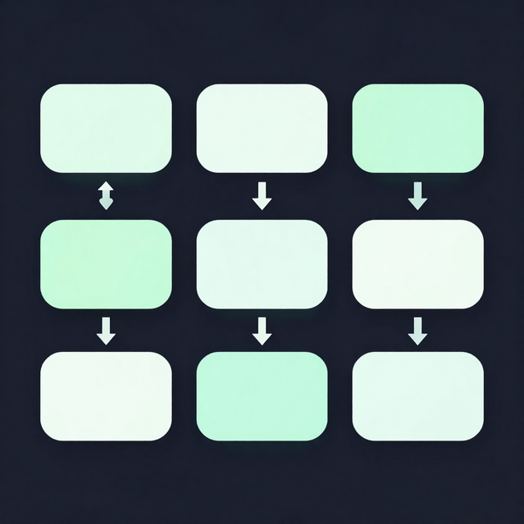
INTERFACE DESIGN APPROACH
Understand Requirement → Map User Task → Structure Information: Every design decision began with a clear understanding of what the feature needed to achieve. From there, user tasks were mapped out to identify the logical flow, and information was structured to reduce cognitive load before any screen layout was drafted.
Design Screen Layout → Refine Visual Hierarchy: With a structured foundation in place, screen layouts were composed to guide the user's eye naturally through each interface. Visual hierarchy was then refined — adjusting spacing, grouping, and emphasis — to ensure the most important elements received appropriate attention.
Review with Development → Iterate & Improve: Completed layouts were reviewed collaboratively with the development team to validate feasibility and alignment with technical constraints. Feedback from these sessions informed iterative improvements, ensuring the final implemented screens remained faithful to the intended design logic and usability goals.

Slide 7
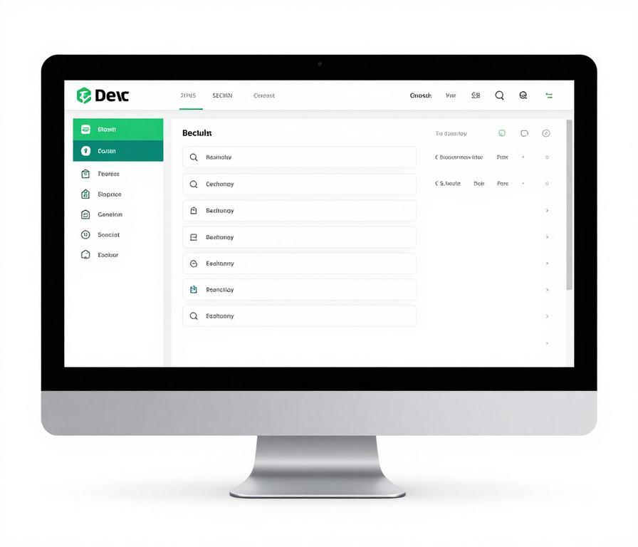
KEY UI PRINCIPLES APPLIED
• Clarity: keeping interfaces clean and easy to read at a glance
• Consistency: uniform patterns, colors, and controls across all screens
• Spacing & Alignment: structured layouts that guide the user's eye naturally
• Readable Information Grouping: related fields and content placed together logically
• Predictable Navigation: users always know where they are and where to go next
• Practical Forms & Responsive Thinking: inputs designed for real use, adaptable across screen sizes

Slide 8

FROM DESIGN TO IMPLEMENTATION
• Prepared structured design handoffs with annotated layouts and component notes
• Communicated layout intent clearly to developers through documented specifications
• Identified design elements requiring adaptation to meet technical constraints
• Reviewed implemented screens against original designs for accuracy and consistency
• Collaborated iteratively with the development team to refine UI details post-build
• Ensured final outputs aligned with intended usability and visual hierarchy goals
Bridging design and development required clear communication and flexibility. By maintaining close collaboration with the development team at ADH Enterprises, design decisions were effectively translated into functional screens, ensuring the final product remained consistent with the intended user experience.

Slide 9
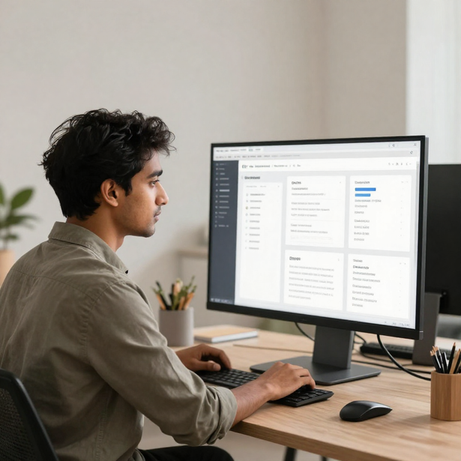
LEARNING OUTCOMES
• Developed user-centered design thinking for real product interfaces
• Gained experience in interface planning and screen layout structuring
• Built understanding of product workflows and end-to-end user journeys
• Strengthened design-development collaboration and handoff skills
• Improved visual communication through hierarchy, spacing, and alignment
• Applied usability evaluation to refine and improve interface decisions
This internship provided Modassir Husain with practical front-end design experience — from interface planning and visual communication to design-development collaboration — building a strong foundation for a career in user-centered UI design.

Slide 10
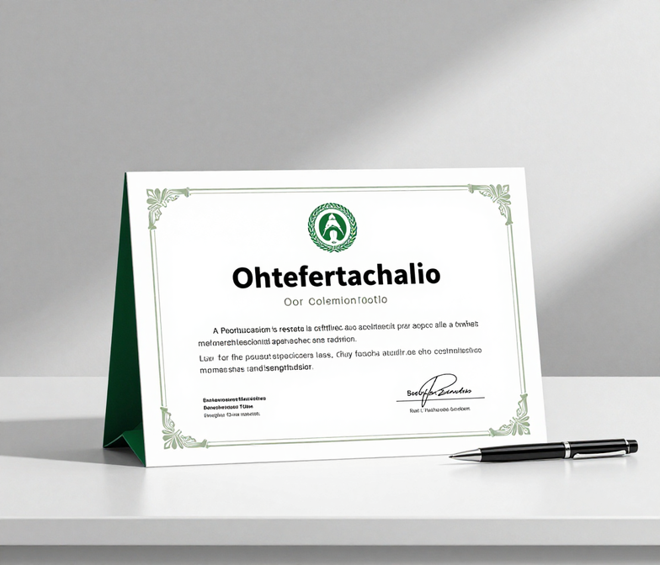
THANK YOU
Key Takeaways:
Gained practical front-end design experience working on a real software product at ADH Enterprises
Contributed meaningful UI design to the ADH ID Generation Software — from layout planning to usability refinement
Developed a stronger understanding of turning product requirements into clear, usable interfaces through real collaboration
Presented by:
Modassir Husain
25SCS1003004509

